Slide 1
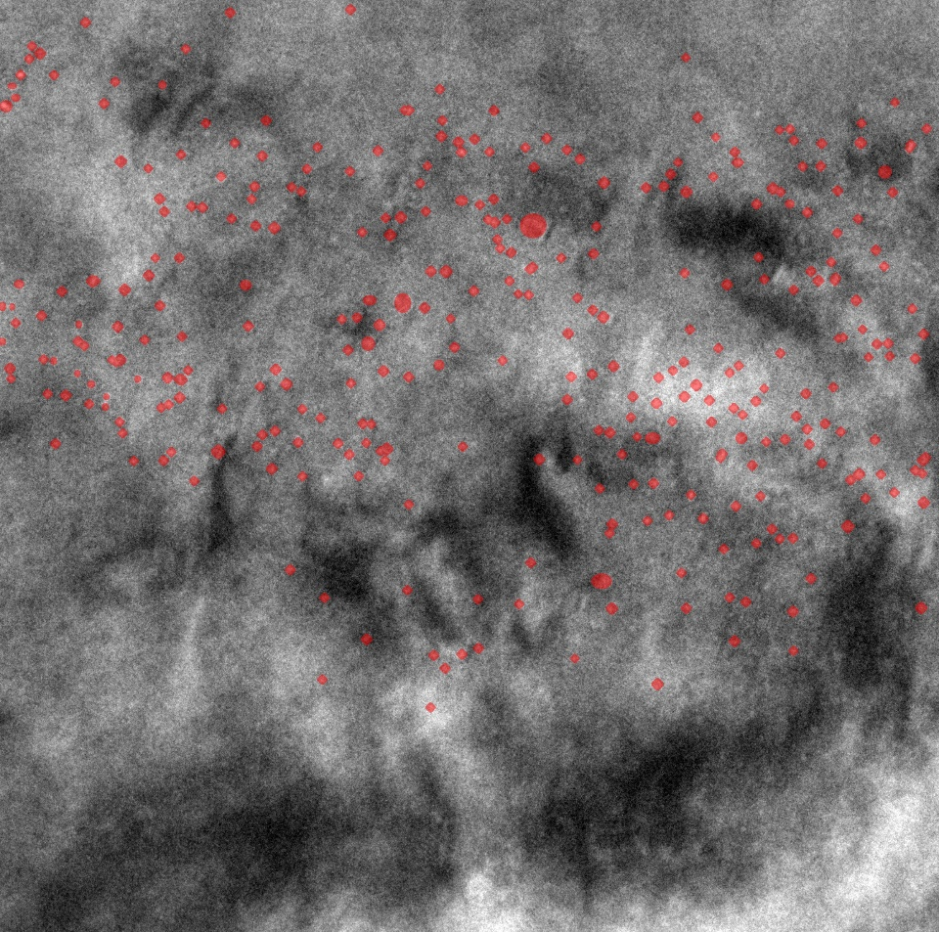
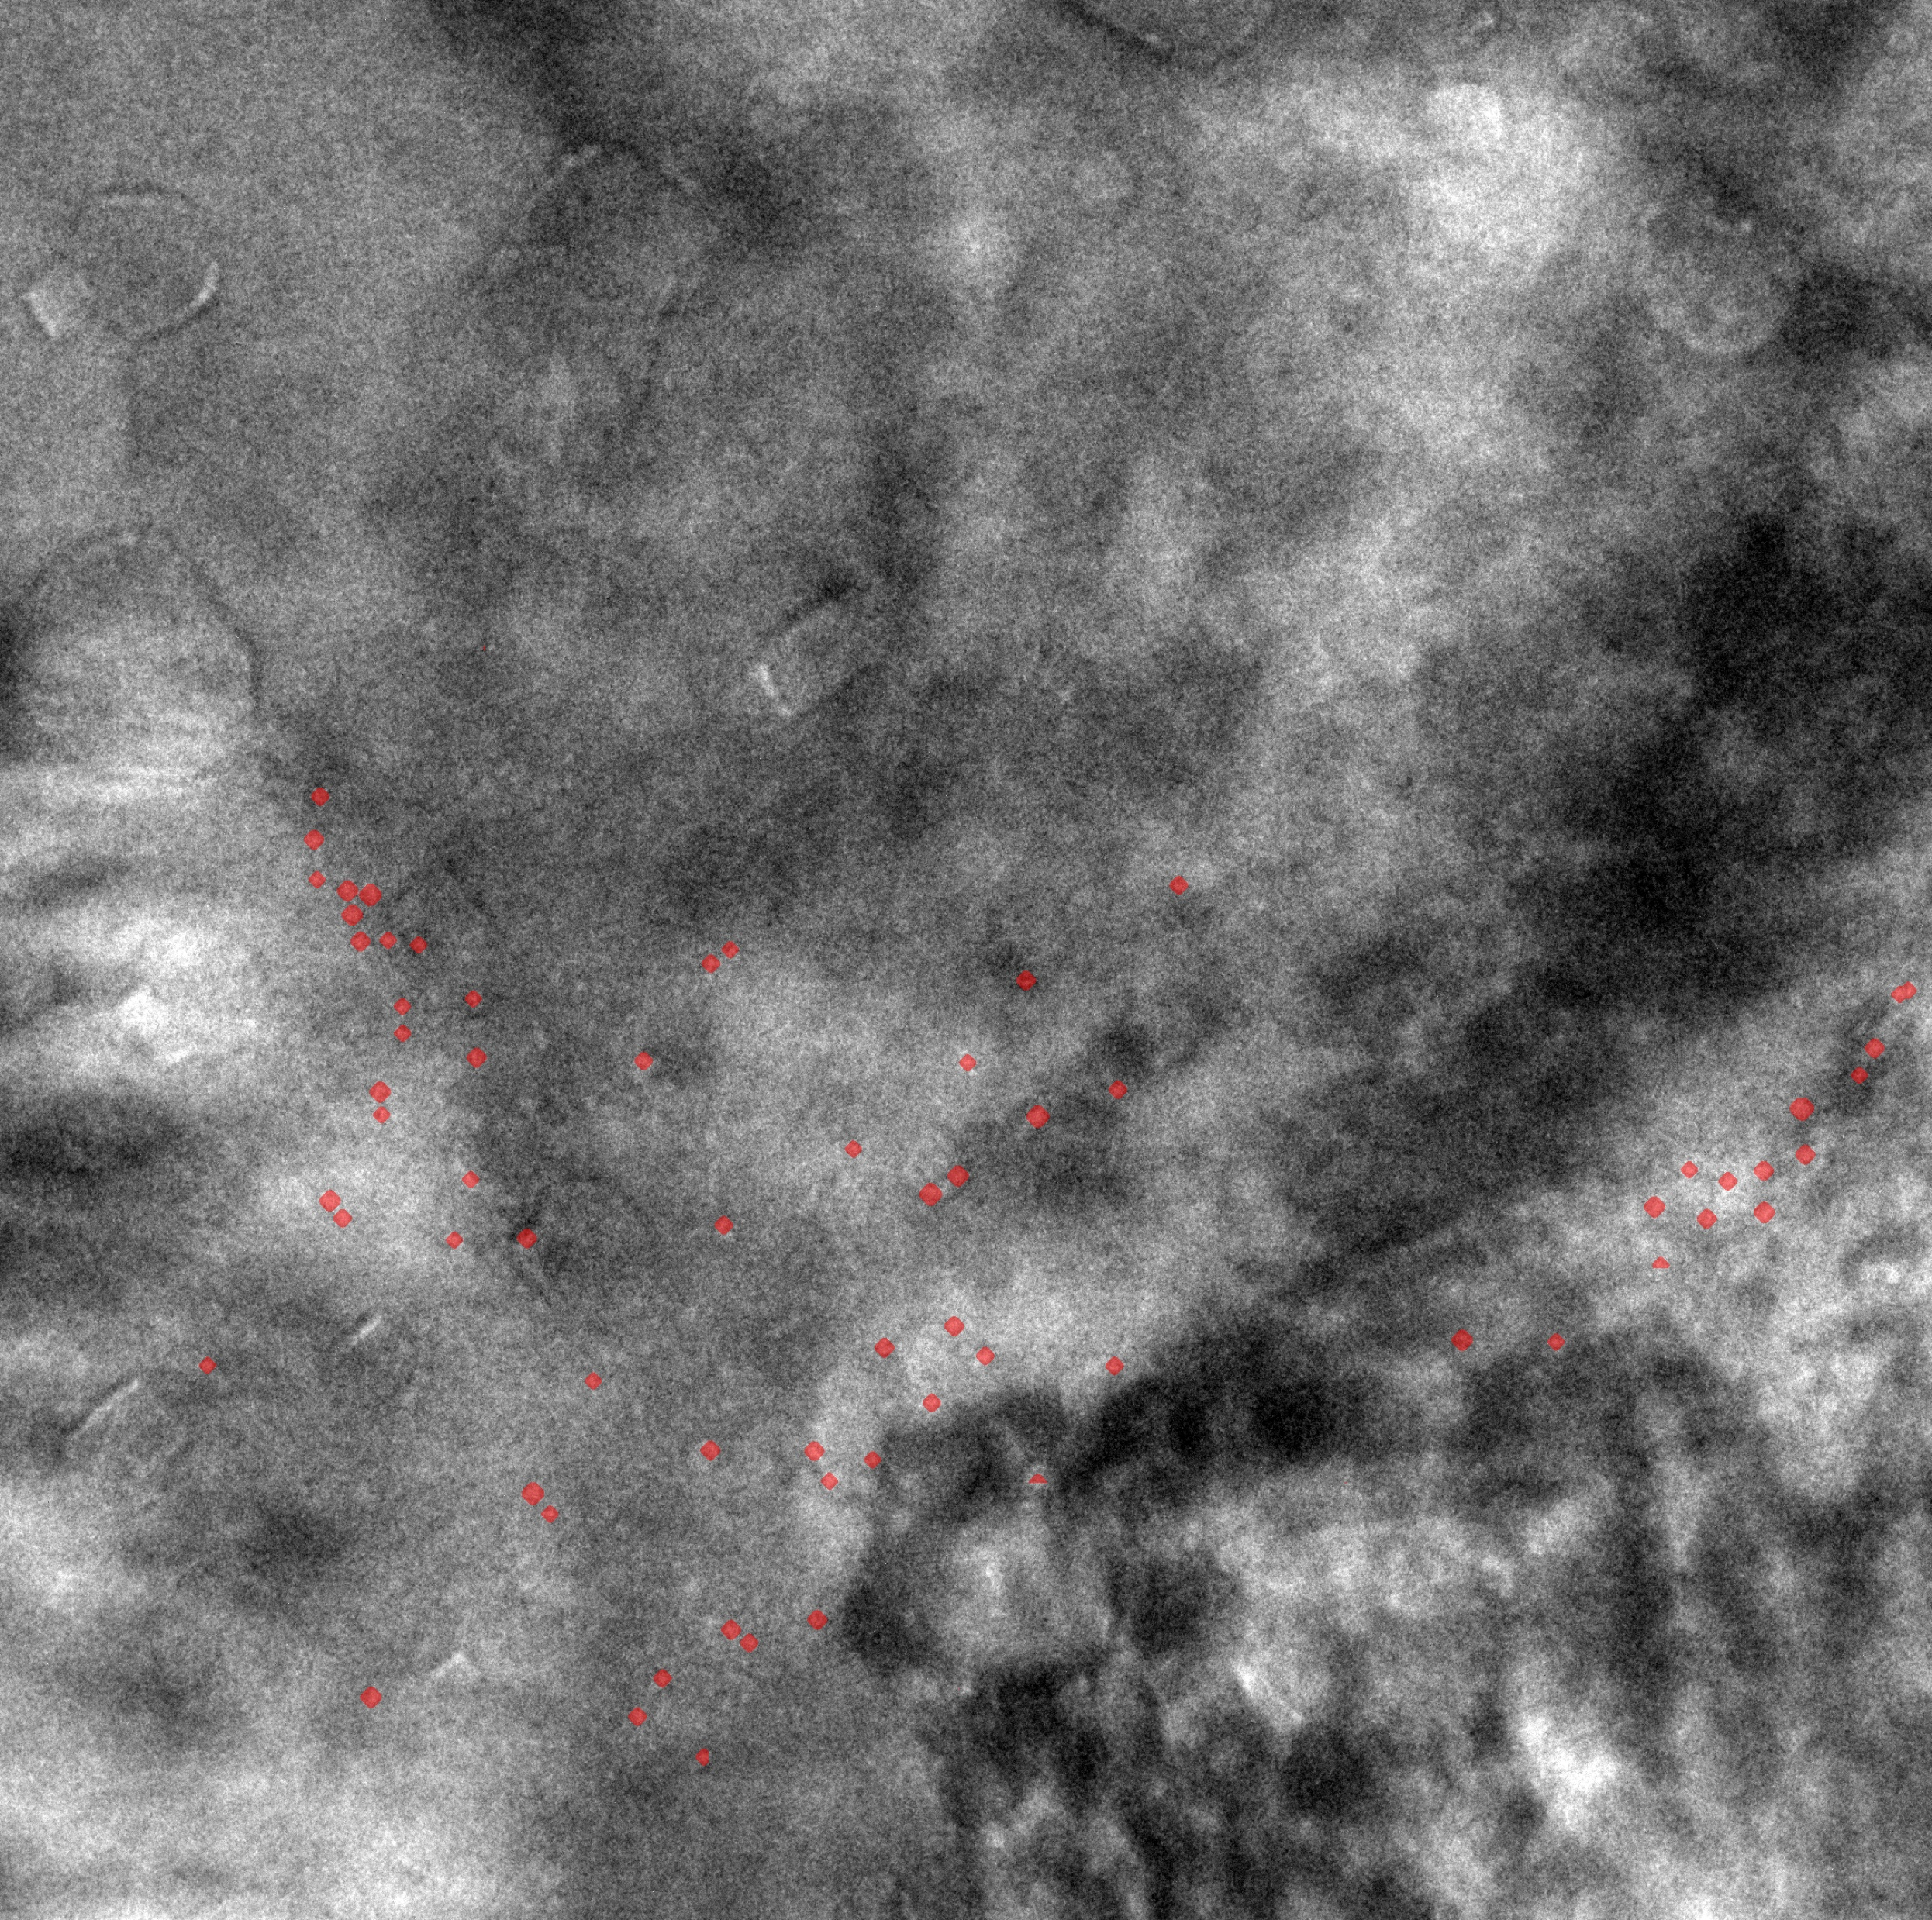
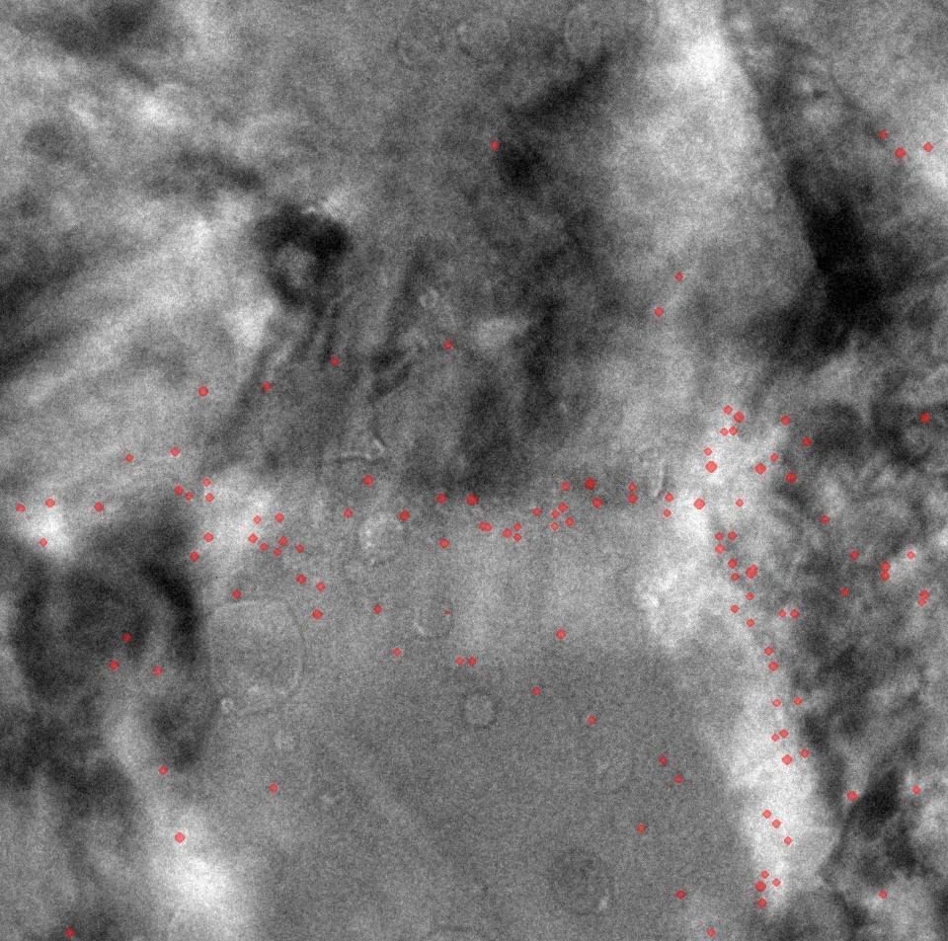
Without iron silicate
With iron silicate
Iron silicate
With iron silicate
Helium bubbles
Grain boundaries
50 nm
Grain boundaries

